Slide 1
FUEL LEVEL GAUGE AND LOW FUEL TELLTALE
By
Shamanth
Anjana
Vasavi
Chaithra

Slide 2
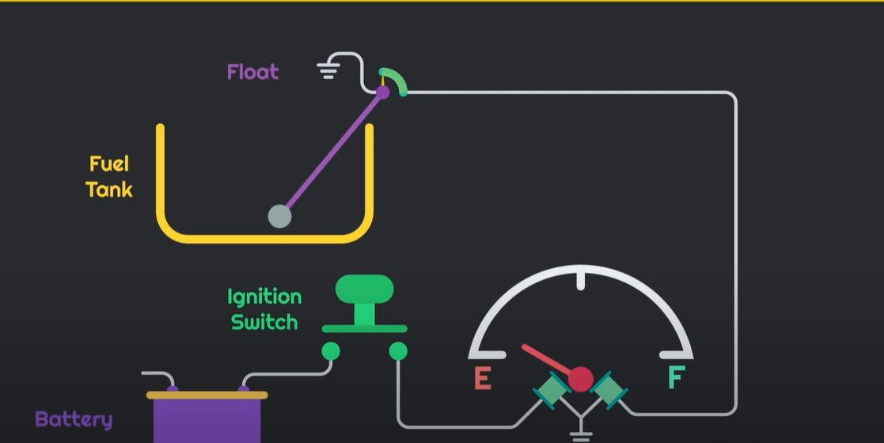
CONSTRUCTION

Slide 3
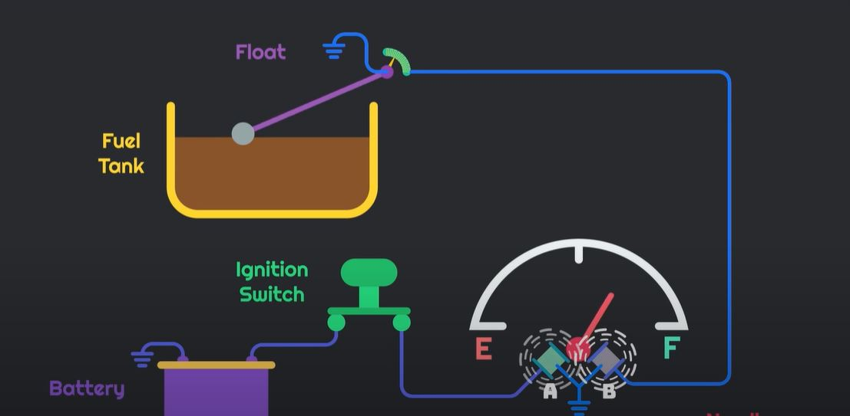
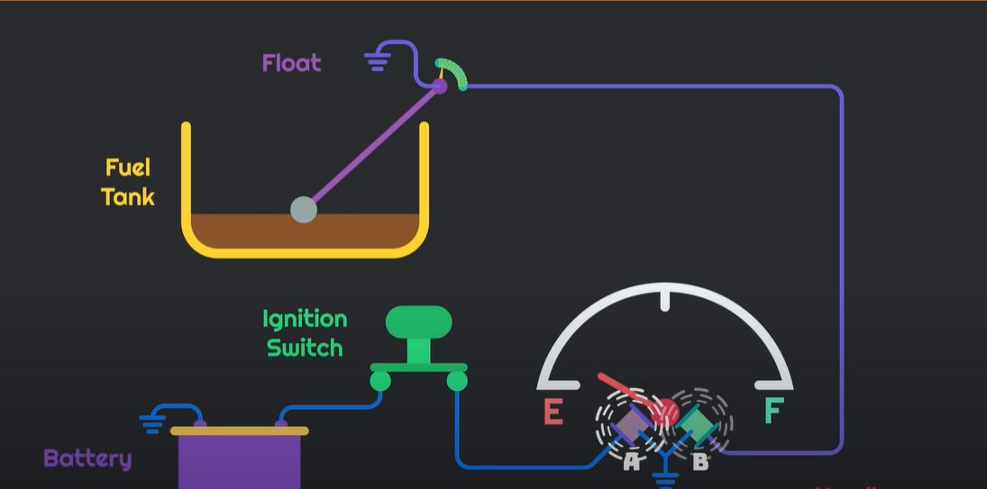
WORKING

Slide 4
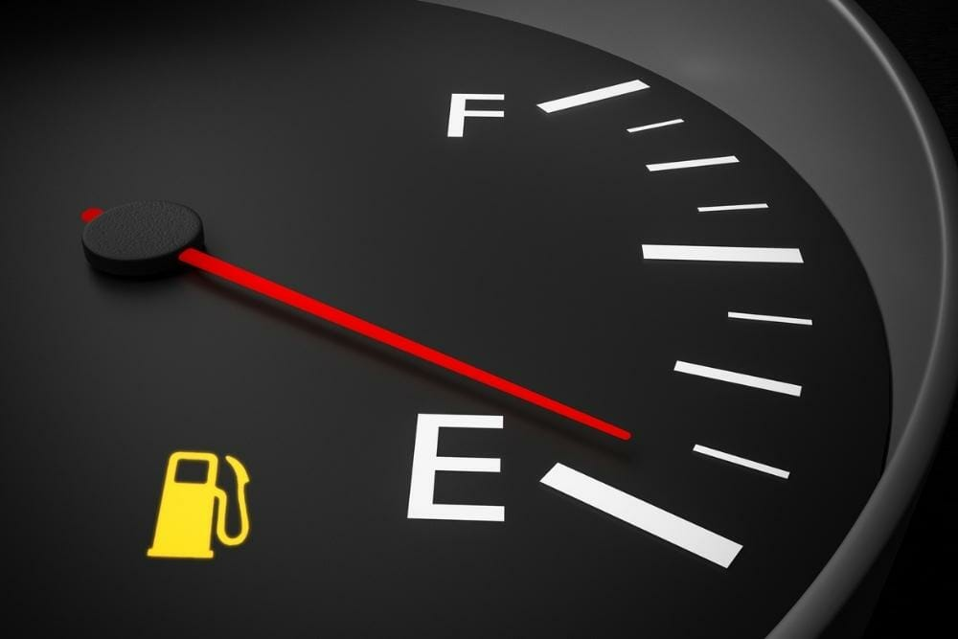
LOW FUEL TELLTALE

